Slide 1
Red Wine Quality
By Yeajoon Yoo

Slide 2
“Vinho Verde” Red Wine Data Set
Red and White wine of the Portuguese “Vinho Verde” Wine
1600 Different Kinds of Wines
Only physicochemical (inputs) and sensory (output) variables are available
There is no data about grape types, wine brand, wine selling price, etc.

Slide 3

What is Good Quality of Wine?
[Cortez et al., 2009] Features:
Input variables (based on physicochemical tests):
1 - fixed acidity
2 - volatile acidity
3 - citric acid
4 - residual sugar
5 - chlorides
6 - free sulfur dioxide
7 - total sulfur dioxide
8 - density
9 - pH
10 - sulphates
11 - alcohol
Output variable (based on sensory data):
12 - quality (score between 0 and 10)
Good Quality value is higher or equal to 6.5.

Slide 4
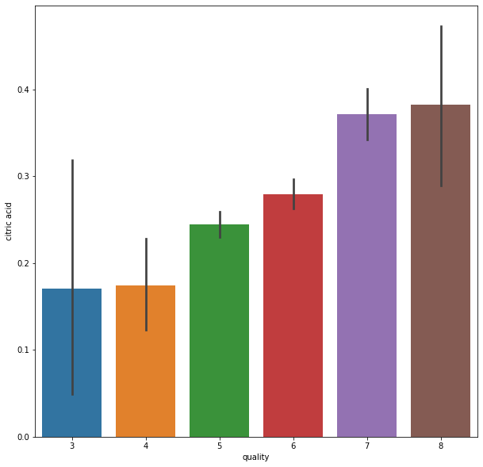
Data Visualization for Good Quality of Wine
Higher Citric Acid better Quality
Citric Acid is found naturally in fruits like Lemons and Limes
Increase Wine Flavor

Slide 5
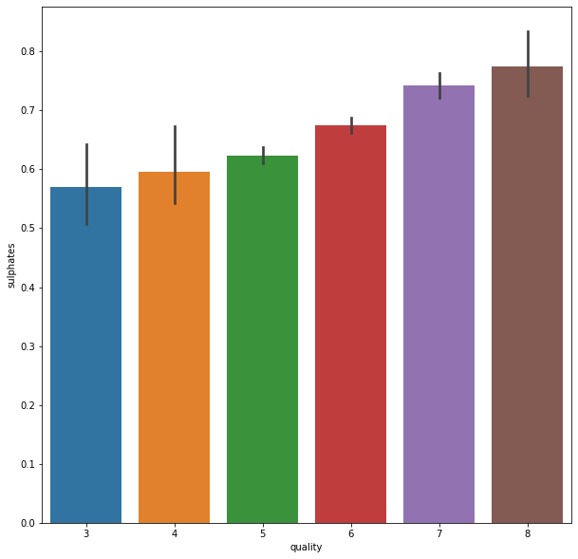
Data Visualization with Various Features
Higher Sulfites wine contain
Better Quality wine have.
Most of Sweet wines contain the most sulfur dioxide content in wine.
https://www.thespruceeats.com/what-are-wine-sulfites-3511277

Slide 6
Machine Learning Models
Prediction of Quality of Wine: Logistic Regression
Which model I tried:
KNeighbors Regression

Slide 7
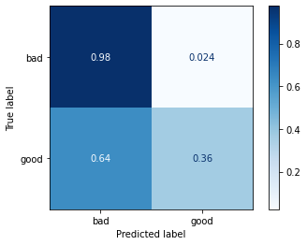
To the stakeholder
From my work, I could find bad quality wines with 98%.
With my model, it is possible to filter the
bad quality of wine to prevent low selling.

Slide 8
Recommendations
Increase Citric Acid
Increase Sulphates (however, see FDA Guidelines)
Decrease Volatile Acidity

